Slide 1


Kadi Sarva Vishwavidyalaya
B. P. College of Computer Studies – BCA
S.V. Institute of Computer Studies - BCA
BCA SEMESTER – V
BCA – 507
“PROJECT PHASE - I”
“Exam Helper”
STUDENT NAME | EXAM NUMBER | ENROLLMENT NUMBER
Patel Dhruv Girishbhai | 015137 | 20BCA04147
Patel Divy Dineshbhai | 015138 | 20BCA04149
Tapodhan Dhruv Jayeshbhai | 015238 | 20BCA04262
Upadhyay Rajan Chiragkumar | 015243 | 20BCA04268

Slide 2
Task :- 1
Project Title :- Exam Helper
Project Definition :- To increase exam performance and Help to achieve target.
Technology Used :-
Front End :- HTML , CSS , J.S
Back End :- ASP.NET , MYSQL

Slide 3
Task :- 2
Project Scope / Objective :-
Exam Helper that will provide you latest five year exam paper according to your stream.
It will Provide all the study material and arrange mock test.
Study of Existing System :-
We analyzed the manual system of Exam Helper , It is helpful for student and teacher also
Paper and materials from each subject are difficult to find.
Student has to go to get the material offline so It is Time consuming for student.

Slide 4
Task :- 2
Advantages :-
Student Does not required internet.
Student can get hardcopy so it is useful for student.
Disadvantages :-
It is Difficult to get material and notes of each subject according to each stream.
Taking offline test Wastes Paper.

Slide 5
Task :- 2
Operational Level Problem :-
It is Difficult to find paper and material offline.
Time Consuming to find papers and materials according to stream.
Technical Level Problem :-
Student have to come and collect the material offline.
Informational Level Problem :-
Finding materials/information offline is difficult.

Slide 6
Task :- 3
Proposed System :-
System Provide latest 5 year paper and material Digitally.
In System all services is free of cost for all the student.
System provide material according to the university , and material is different for each university , System provide mock test also.
Student can put their own material on System so that if someone doesn’t want to use our material , they can get another material also.

Slide 7
Task :- 3
Proposed System Advantages :-
Quick Access
Student can get all Paper and material digitally.
Student can give mock test.
Save the Student time.
Free of Cost.

Slide 8
Task :- 3
Proposed System Disadvantages :-
Material Mismatched.
Some time University answer is different and system answer is different.
Student Does not Get Hard Copy of any Paper and Material.

Slide 9
Task :- 3
SRS including functional requirement and non-functional requirement :
• Hardware and Software
❖ Client Side: -
Hardware Specification(minimum)
▪ CPU: - Ryzen / Intel - 2.20 GHz
▪ Ram: - 1 GB ▪ HDD: - 500MB
▪ Laptop / Mobile / PC
Software Specification (minimum)
▪ Windows 7/8/10/11S
▪ Mozilla Firefox
▪ Internet Explorer or Chrome

Slide 10
Task :- 3
❖ Developer Side: -
➢ Hardware Specification(minimum)
▪ CPU: - Ryzen / Intel 4.2GHz
▪ RAM: - 2GB
▪ HDD: - 1Gb
➢ Software Specification(minimum)
▪ Windows 8/10
▪ Front End Tool :-
o Designing Tool: - Visual Studio 2019
o Scripting Tool: - ASP. Net
▪ Back End Tool: -
o MySQL Server

Slide 11
Task :- 3
Server Side: -
➢ Hardware Specification(minimum)
CPU: - Ryzen / Intel 4.2GHz
RAM: - 8GB
HDD: - 1GB , SSD:- 1GB
➢ Software Specification(minimum)
Apache

Slide 12
Task :- 3
Functional Requirement :-
This section provides requirement overview of the system. Various function modules that can be implemented by the system.
Login / Registration
Select University.
Select Stream.
Download Paper.
Apply for mock.
Get Instant Result.

Slide 13
Task :- 3
Non-Functional Requirement :-
The system shall be user friendly and consistent.
Performance and Scalability .
Availability :- Website will be available and working properly for all the time (24 hours).
Security.

Slide 14
Task :- 3
Feasibility Study :-
Operational Feasibility.
Technical Feasibility.
Economically Feasibility.
Scheduled Feasibility.

Slide 15
Task :- 3
Operational Feasibility :-
This project is being made for the platform owner and student only , This system will greatly reduce a huge student time and money.
2. Technical Feasibility :-
Easy to search Material and Paper at one platform.

Slide 16
Task :- 3
3.Economic Feasibility :-
Proposed system gives more facilities.
Development cost is less.
4.Schedule Feasibility :-
It is management in have given some schedule time to complete your project.

Slide 17
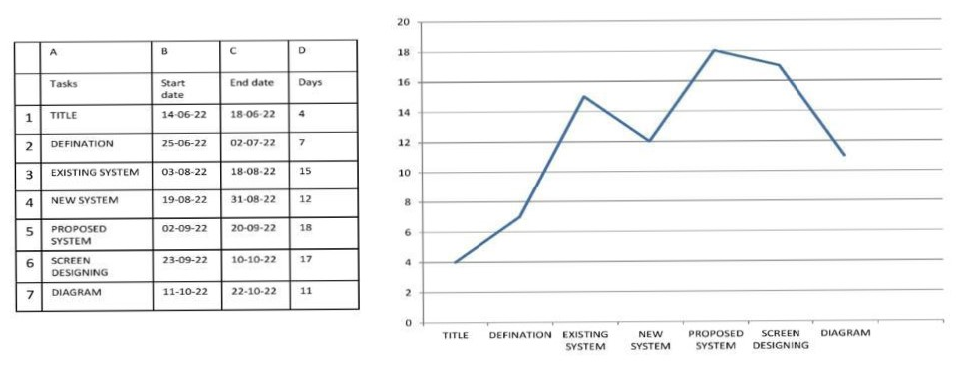
Task :- 3

Slide 18
Task :- 4
Proposed System Module : -
Admin.
User.
Admin :-
Login
Add Papers and Material
Add Mock test question
Manage Users , Papers and Material
View Feedback

Slide 19
Task :- 4
2. User :-
Registration/Login
Search University
Select Stream
Download Exam Paper and material
Give Mock Test
Give Feedback

Slide 20
Task :- 4
Registration
Username
Mobile Number
Screen Designing
E-mail Address
Create Password
Confirm Password
Send OTP
Enter OTP
Sign Up

Slide 21
Task :- 4
Login
Username
Password
Login
Forgot Password
Don’t have an account ? Sign up

Slide 22
Task :- 4
User DashBoard
Exam Helper
Home University Stream Log Out About us
Home
Paper
Material
Mock Test

Slide 23
Task :- 4
OnClick Paper
Exam Helper
Home University Stream Log Out About us
Paper
Search
University List
College List
Stream List
Download Paper’s
Gujarat University
H.L College Of Commerce
B.Com
Download

Slide 24
Task :- 4
OnClick Material
Exam Helper
Home University Stream Log Out About us
Material
Search
University List
College List
Stream List
Download Material
Gujarat University
H.L College Of Commerce
B.Com
Download

Slide 25
Task :- 4
OnClick Mock Test
Exam Helper
Home University Stream Log Out About us
Mock Test
Search
Stream List
Question List
Result
B.Com
Give Test
Get Result

Slide 26
Task :- 5
Zero Level DFD
User
Reg/login
Exam Helper
Admin
0
Login
Login Successfully
User Reg/login
Paper/Material Request
Approve Reg/login
Get Paper/Material
Provide Paper/material

Slide 27
First Level DFD
Task :- 5
1
Reg/
Login
Reg/Login req.
Reg/Login req.
Approve Reg/Login.
Approve Reg.
login
Save Reg. Detail
material db
reg db
Provide Material
Store material
Req. for material
2
Select University & Select Stream
Download
Paper material
User
Add Paper & Material
Admin
Req for Paper & Material
University & Stream Details
Download Paper & Material
Provide Paper & Material
que_ans db
result db
Mock detail
Ques detail
3
Get result
Mock Test
Give Mock Test
Add Que & Ans
Receiver mock Result
User Test Details

Slide 28
Second Level DFD
Registration
Task :- 5
Registration
Reg details
1.1
Save reg det
Reg approve
reg db
Updated Password
Verify User Password
Confirm Password
Verify admin pass
Login
1.2
Confirm pass
Login Done
Username /
Password
User
Admin
Username /
Password
Login Done
Forgot/
Password
1.3
Forgot Password
Enter new Password
Forgot Password
Enter new Password
Password Changed
successfully
Updated Password

Slide 29
Second Level DFD
Download material
Task :- 5
Download info
Download
paper
2.1
Select university & college
Select stream
Add Paper
Download Paper
Check detail
Get paper
material db
Check detail
Download
Material
Get material
2.2
User
Select university,college
Add Material
Admin
Select stream
Download info
Download
material
Cancel
2.3
Cancel download
Cancel info

Slide 30
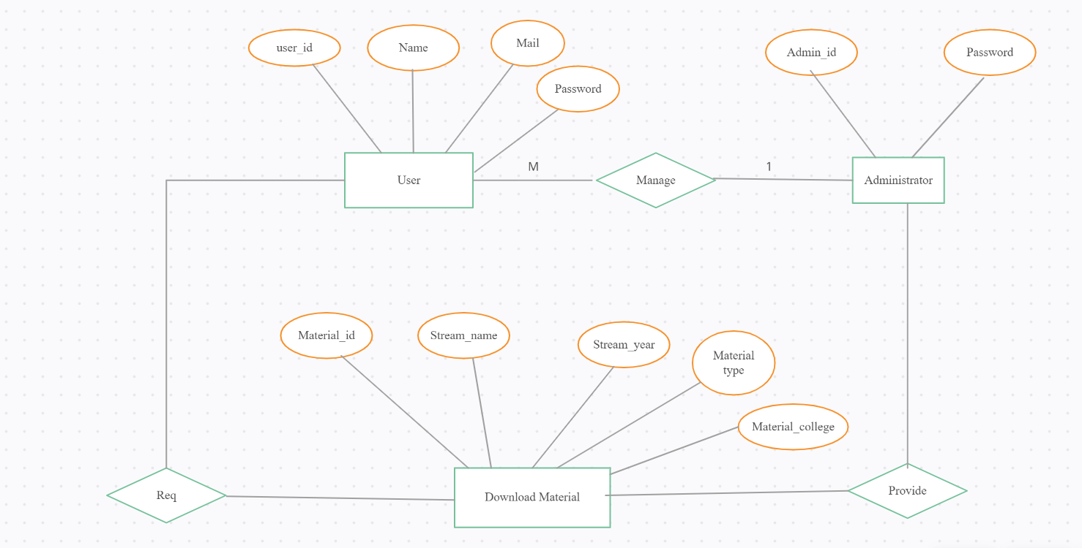
Task :- 6
ER Diagram

Slide 31
Data Dictionary
Task :- 6
Registration Table User Registration Table
No | Field Name | Data type | Field Length | Constraint | Description | Example
1 | user_id | Integer | 10 | Primary Key | User’s Special id | 1001
2 | User_name | Varchar | Max | Not null | User’s name | Divy
3 | User_mail | Varchar | Max | Not null | Customer’s mail | rajan760li@gmail.com
4 | User_mobile | Varchar | Max | Not null | Customer’s Password | Rajan123#@
5 | User_password | Integer | 10 | Not null | Customer’s Phone no. | 9879924100
6 | Datetime | Date | Max | Not null | Registration Date | 10/09/2022

Slide 32
Data Dictionary
Material Table College / Stream according Material data Table
No | Field Name | Data type | Field Length | Constraint | Description | Example
1 | Material_id | Integer | 10 | Primary Key | Material’s Special id | 001
2 | Course_id | Integer | 10 | Foreign Key | Course’s Special id | 1
3 | course_name | Varchar | Max | Not null | Stream name | BCA
4 | course_year | Varchar | Max | Not null | Stream Year | BCA 1 year
5 | Material_type | Varchar | Max | Not null | Material Type | PDF/Doc
6 | Material_college | Integer | 10 | Not null | Material Provided By college | B.P College of Computer Studies.

Slide 33
Data Dictionary
Question Table Stream According Question Table
No | Field Name | Data type | Field Length | Constraint | Description | Example
1 | qus_id | Integer | 10 | Primary Key | Qus’s Special id | 1
2 | Material_id | Integer | 10 | Foreign Key | Material Special id | 001
3 | que_desc. | Varchar | Max | Not null | Question Desc. | Full Form of MVC
4 | Choice1 | Varchar | Max | Not null | Option 1 | Model Controller
5 | Choice2 | Varchar | Max | Not null | Option 2 | Model View Control
6 | Choice3 | Varchar | Max | Not null | Option 3 | Model Controller
7 | Choice4 | Varchar | Max | Not null | Option 4 | Model View
8 | que_ans | Integer | 10 | Not null | Question Answer | Model View Controller

Slide 34
Data Dictionary
Result Table Mock Test Result Table
No | Field Name | Data type | Field Length | Constraint | Description | Example
1 | result_id | Integer | 10 | Primary Key | Result Special id | 100
2 | user_id | Integer | 10 | Foreign Key | User’s Special id | 1001
3 | que_id | Integer | 10 | Foreign Key | Material id | 001
4 | Datetime | Date | Max | Not null | Registration Date | 10/09/2022

Slide 35
Data Dictionary
Download Table Material Download Table
No | Field Name | Data type | Field Length | Constraint | Description | Example
1 | dow_id | Integer | 10 | Primary Key | Download’s Special id | 1
2 | user_id | Integer | 10 | Foreign Key | User’s Special id | 1001
3 | Material_id | Integer | 10 | Foreign Key | Material id | 001
4 | Course_id | Integer | 10 | Foreign Key | course id | 001
5 | Datetime | Date | Max | Not null | Registration Date | 10/09/2022

Slide 36
Data Dictionary
Course Table
No | Field Name | Data type | Field Length | Constraint | Description | Example
1 | Course_id | Integer | 10 | Primary Key | course’s Special id | 1
2 | Course_name | Varchar | 50 | Not null | Course Name | BCA
3 | Course_year | Integer | 10 | Not null | Course year | 3

Slide 37
Data Dictionary
Admin Table
No | Field Name | Data type | Field Length | Constraint | Description | Example
1 | Admin_id | Integer | 10 | Primary Key | Admin’s Special id | 1
2 | user_id | Integer | 10 | Foreign Key | User’s Special id | 1001
3 | Material_id | Integer | 10 | Foreign Key | Material id | 001
4 | que_id | Integer | 10 | Foreign Key | Material id | 001
5 | result_id | Integer | 10 | Primary Key | Result Special id | 100
6 | dow_id | Integer | 10 | Primary Key | Download’s Special id | 1

Slide 38
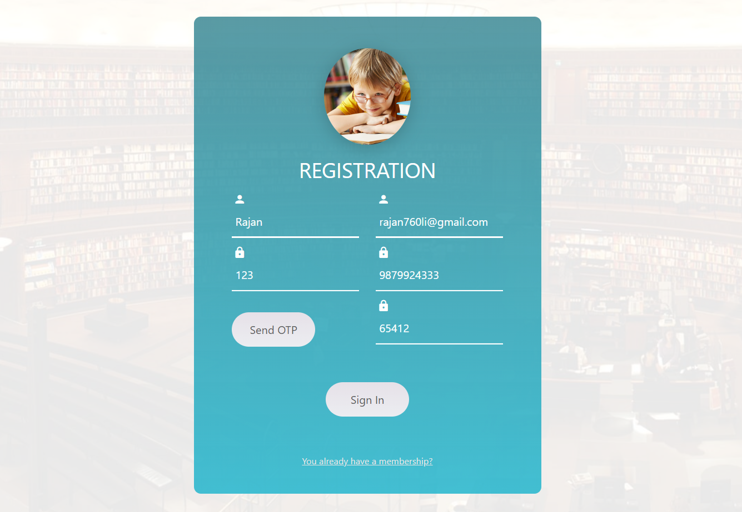
Task :- 7

Slide 39
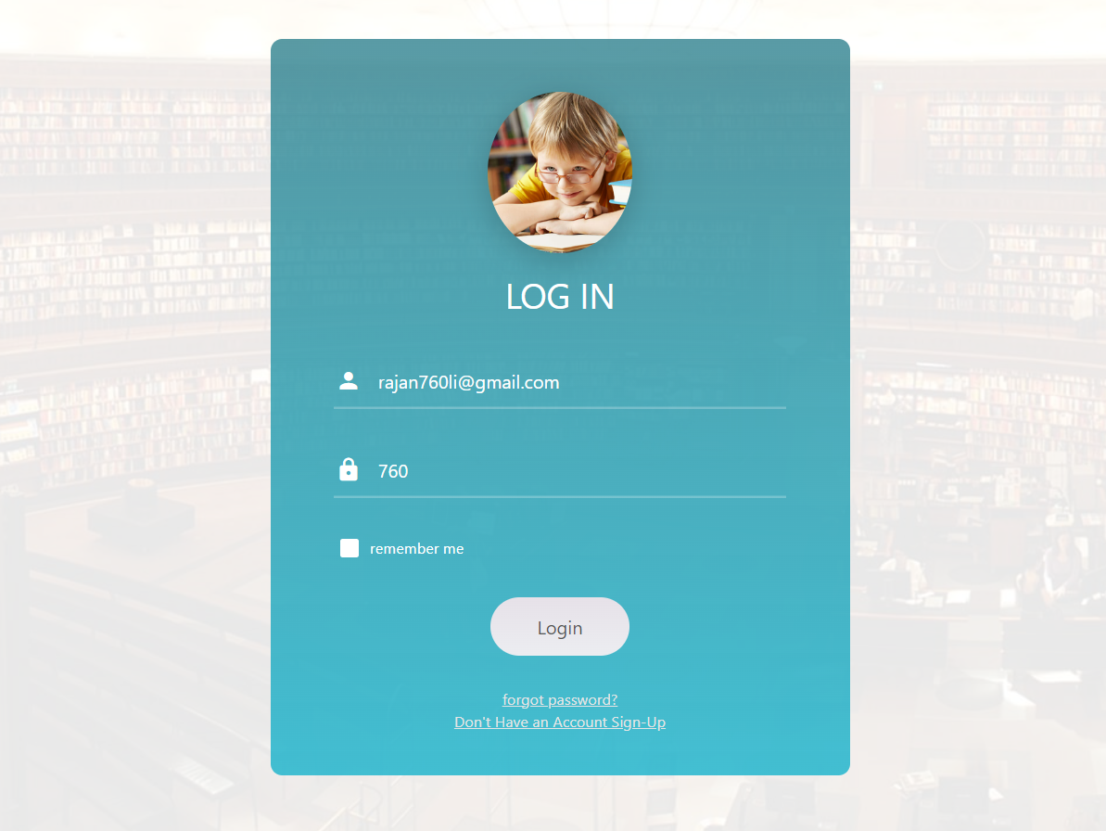

Slide 40
